Slide 1
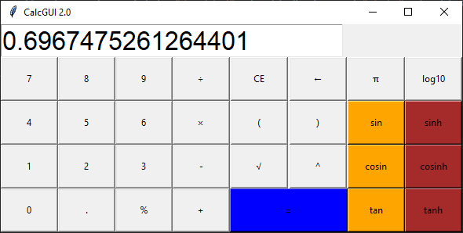
CalcGUI 2.0
Taking Tkinter math integration to the next scientific level!
https://github.com/ksu-is/CalcGUI-2.0
Rahul Bhanshali

